Slide 1
Overview of Wireless Systems:

Slide 2
Infrastructure-based vs Ad-hoc
Infrastructure Network
Infrastructure networks are networks with pre-defined infrastructure and it is made from fixed-size of nodes.
Here network services are delivered through pre-constructed infrastructures.
In this network Access point is the central controller for each device.
Access points are nothing but fixed base stations that are connected by wires.
It is impossible for remote localities to install such a network as it is too expensive.
All devices on a wireless network are communicated through a router i.e. access point.
Examples are Wireless LAN, satellite networks, etc.

Slide 3
Ad-hoc Network
This type of network is a group of independent terminals that communicate with each other by forming a radio network.
The links in wireless networks have less bandwidth as compared to the wired networks.
In this network, each node is act as a router, and network connection is distributed among nodes.
In an ad-hoc network, the formation of networks takes place dynamically with the help of a collaboration of random nodes.
Examples of infrastructure-less networks are Wireless Sensor Networks (WSN), and Mobile Ad hoc networks (MANETs).

Slide 4
Differences between Infrastructure and Infrastructure-less Networks (Ad hoc)
Infrastructure Network | Infrastructure-less Network (Ad hoc)
This network is faster than Ad hoc network. | This network is slower than infrastructure network.
This network provides more security options. | This network provides fewer security options.
In this network access point handles all wireless nodes which are present in range. | There is no need for access point in Ad hoc networks.
Applications are IEEE 802.11 and HIPERLAN2. | Bluetooth is a type of Ad hoc network.
This network used frequently in hotel lobbies, airport lounges, train stations, etc. | This networks are frequently used in the military, local networks are used for communication among a fixed group of people, etc.
For the set up of a permanent network, an infrastructure network is used. | For the set up of a temporary network, an Ad hoc network is used.

Slide 5
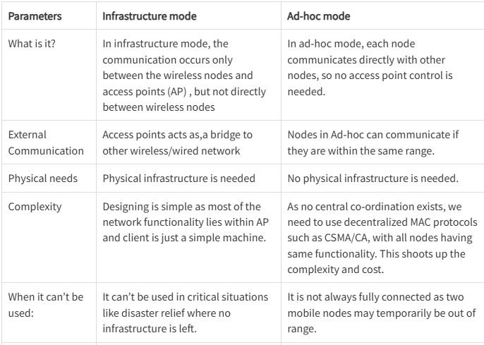

Slide 6
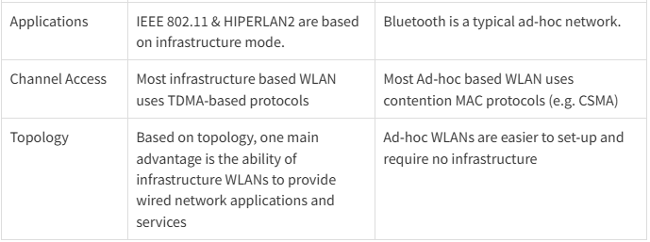

Slide 7
Ad hoc mode WLAN and infrastructure mode WLAN are two different operational modes for wireless local area networks (WLANs), each with its own characteristics and use cases. Here are the key differences between these two modes:
Ad Hoc Mode WLAN:
Peer-to-Peer Communication: Ad hoc mode creates a decentralized network where wireless devices communicate directly with each other without the need for a central access point (AP) or infrastructure. In this mode, devices act as both clients and access points simultaneously.
Spontaneous and Temporary: Ad hoc networks are typically set up spontaneously and temporarily. Devices within the network connect directly to one another for a specific purpose, such as file sharing or gaming, and the network dissolves when devices disconnect.
Limited Range: Ad hoc networks have limited range because devices must be within direct radio communication range of each other. The range is typically shorter compared to infrastructure mode due to the absence of powerful APs.
No Central Control: There is no central control or management in ad hoc mode. Devices communicate directly with each other, and there is no coordination by a central entity like an AP.
Scalability Challenges: Ad hoc networks are less scalable than infrastructure mode networks because adding more devices can lead to increased complexity and potential performance issues.

Slide 8
Infrastructure Mode WLAN:
Centralized Architecture: In infrastructure mode, a central access point (AP) serves as the hub of the network. Client devices connect to the AP, which acts as a bridge between wireless clients and the wired network infrastructure.
Extended Range: Infrastructure mode offers extended range compared to ad hoc mode because APs are often strategically placed throughout an area to provide coverage. This allows for larger coverage areas and roaming between APs.
Scalability: Infrastructure mode is highly scalable. Additional APs can be added to expand coverage and support more devices without significantly increasing network complexity.
Network Management: Infrastructure mode enables centralized network management. Network administrators can monitor and configure the network through the APs, making it easier to control security settings, quality of service (QoS), and other network parameters.
Wired Network Integration: Infrastructure mode seamlessly integrates with the wired network infrastructure, allowing wireless clients to access resources such as printers, servers, and internet connections.
Common in Public Wi-Fi: Infrastructure mode is commonly used in public Wi-Fi networks, enterprise networks, and home networks where a centralized hub (the AP) is essential for providing reliable and extended coverage.

Slide 9
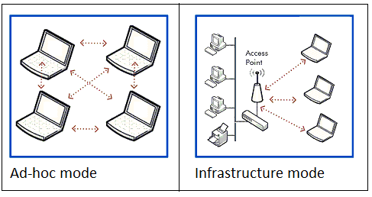
In summary, ad hoc mode WLANs are suitable for small, spontaneous, and temporary networks where devices communicate directly with each other. Infrastructure mode WLANs are ideal for larger, more permanent networks that require centralized management, extended coverage, and integration with a wired infrastructure. The choice between these modes depends on the specific requirements and use cases of the wireless network.

Slide 10
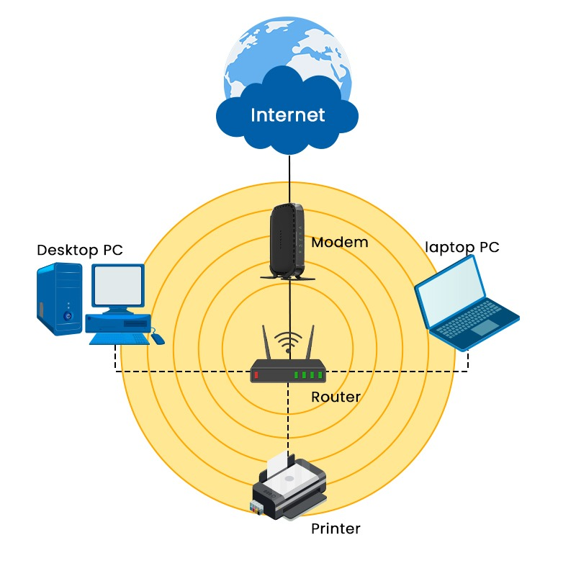
Wireless LANs
WLAN stands for Wireless Local Area Network.
What is Wireless LAN in computer networks?
It is a network comprising two or more computing devices that communicate through radio waves without the need for physical connections.
It employs wired connectivity, where by every computer within the network is physically linked to the network switch or hub via an Ethernet cable.

Slide 11
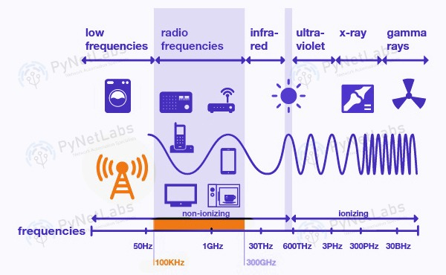
How Does Wireless Local Area Network Work?
Understanding the functioning of WLAN is straightforward. The operational principles of LAN networking are nearly identical. The only difference is that WLAN allows the connection of devices to a network without the need for a physical cable.

Slide 12
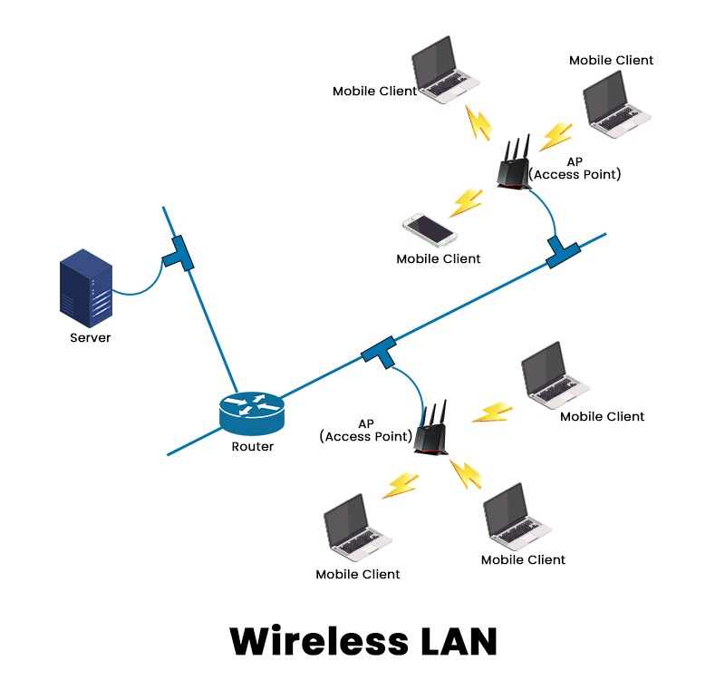
Wireless Local Area Network (WLAN) employs radio frequency waves to help with the transmission and reception of data among various devices, such as a wireless router and a laptop.

Slide 13
WLAN
A Wireless Local Area Network (WLAN) implements a flexible data communication system frequently augmenting rather than replacing a wired LAN within a building or campus.
How does a WLAN work?
Like broadcast media, a WLAN transmits information over radio waves. Data is sent in packets. The packets contain layers with labels and instructions that, along with the unique MAC (Media Access Control) addresses assigned to endpoints, enable routing to intended locations.

Slide 14
WLAN architecture
Stations:Stations are components that connect wirelessly to networks. They are either access points or endpoints, each identified with a unique network address.
Basic Service Set (BSS):A BSS is a group of stations that connects to the network. In ad hoc networks, the group of stations is called an Independent BSS (IBSS). A set of connected BSSs, as in a network with multiple access points, is called an Extended Service Set (ESS).
Distribution system:The distribution system connects access points in an ESS. The connections can be wired or wireless. A wireless distribution system (WDS) can use mesh or its own WDS protocol. Fixed wireless is a specialized form of radio transmission for connecting a geographically distant access point.
Access point:The access point is the base station that serves as a hub to which other stations connect. The "access" is that of the stations to the network, but it may also mean internet access, since many routers double as internet modems. In an ESS, access points may be connected with Ethernet cables or wirelessly.
Bridge:The bridge is used to connect a WLAN to a LAN or to an access point.
Endpoint:The endpoint is any end-user station, such as a computer, mobile device, printer, or Internet of Things (IoT) device.

Slide 15
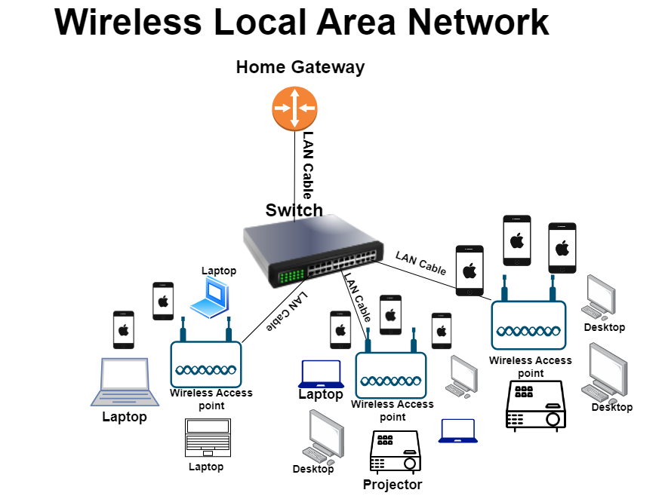
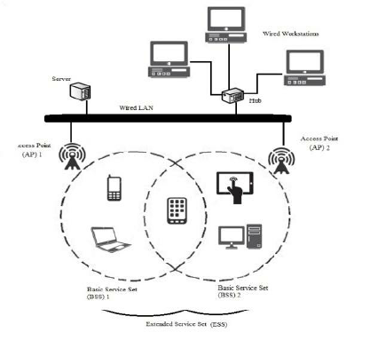

Slide 16
Advantages of WLAN
Mobility:It provides “Anywhere Anytime” access of data and information. It provides support of real time information facilitating decision making in time critical events like Stock updates.
Low implementation costs: As compared to wired LAN the implementation costs in terms of manpower, time, complexity of installation is less. It is easy to setup, relocate, change and manage a WLAN. Initial costs for hardware may be higher than wired networks, but overall installation expenses and life cycle costs are lower.
Installation Speed: It does not involve setting up cables and other components and arranging in form of required topology. Just configure a router and connect devices. It’s that simple.
Network Expansion: “Wireless can go where wires cannot”. It can be laid where it is not possible to lay down a wired network like under the sea. The transmission can penetrate through buildings and walls.

Slide 17
Higher Capacity: More users can be accommodated as compared to wired. For example in wired, a separate cable needs to be laid for each subscriber but for a cellular WLAN the capacity is increased manifold as per the channel availability. For eg. If a channel caters 10 subscribers and 100 channels are available, 1000 subscribers can be accommodated.
Reliability: No fear of downtime due to cable failure which is the primary cause of failure in wired network
Scalability: It is easy to scale a WLAN to increase number of users as configurations can be easily changed as no fixed topology exists.
ISM band: It operates on license free band whether it is infra-red band or ISM band.
Robustness: The WLAN can survive disasters eg. Earthquakes. If the devices are not damaged, network won’t be affected.
Planning: Don’t need additional plan of wires, plugs, switches etc. The WLANs can be adhocly setup with the use of devices following same standard.

Slide 18
Types of WLAN
As per the type of EM waves used for transmission, the WLAN can be divided into two categories:
Infra-red WLAN: Infrared LAN uses LED, LASER, diffused bulbs as sources of energy and the receivers are photoreceptors sensitive to light. Operates on 900nm band. Eg. IrDA (Infrared data association)
Radio based LAN: The antennas used in radio based LANs work on 2.4 GHz ISM band.
Eg. Bluetooth, Wi-fi etc.

Slide 19
Flavours of WLAN
HiperLAN: “HiperLAN is a set of wireless local area network communication standards primarily used in European countries. There are two specifications: HiperLAN/1 and HiperLAN/2. Both have been adopted by the European Telecommunications Standards Institute (ETSI). HiperLAN/1 provides communications at up to 20 Mbps in the 5-GHz range of the radiofrequency (RF) spectrum. HiperLAN/2 operates at up to 54 Mbps in the same RF band. HiperLAN/2 is compatible with 3G (third-generation) WLAN systems for sending and receiving data, images, and voice communications.
IEEE 802.11: IEEE 802.11 is a standard for Local Area Networks using the ISM band from 2.4-2.5 GHz.

Slide 20
HomeRF: This is a standard providing interoperability between PC and electronic devices at home.
Bluetooth: It is standardized as a personal area network for interconnecting devices in ad hoc fashion.
MANET: MANET is a working group within IETF to investigate and develop standards for Mobile ad hoc networks.
Internet Engineering Task Force

Slide 21
Cellular System
Cellular Systems or networks are a technology in which a wide geographical area is broken up into small units called cells.
The basic motive of cellular technology was to use many low power transmitters strategically placed all over the geographical region.
Neighboring cells are assigned distinct frequencies or channels which can be reused after a certain distance by the means of clustering thus facilitating frequency reuse.
To improvise the situation, cellular telephone service was conceived at Bell labs.
The system consisted of low power transmitter spreaded strategically throughout the city facilitated with frequency reuse and automatic call handoffs.
The reason for having low power antennas was that the transmission of antennas would reach only to a certain range beyond which the signal strength decreases.

Slide 22
So the same channel can be used once the device is out of range of the transmitter.
This is the principle behind cellular technology known as frequency reuse.
The goal is to improve the spectral efficiency by providing services to millions of subscribers within limited spectrum.
This is the principle behind the cellular technology. Large geographical area is divided into small geographic regions called cells hence the name cellular technology and the conventional radio phones got the names cell phones.

Slide 23
Cellular System Architecture
Cell : is a basic geographic unit of a cellular system.
It comprises of small area which has a low power antenna installed in the form of a unit called the base station.
The location of base station depends on whether the antenna is omnidirectional or directional.
Center excited cells: Uses omnidirectional antennas and the base station is at the center of the cell
Edge excited cells: Uses directional antennas and the base station is at the periphery of the cell

Slide 24
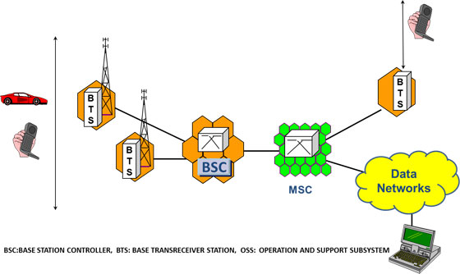

Slide 25
It is essentially a the areas which is divided into cells , services and connected to each other by collection of transceivers, controllers, switches, routers, and registers.
Mobile Equipment (ME) – This refers to the physical phone itself. The phone must be able to operate on a cellular network. Older phones operated on a single band only. Newer phones are dual-band, triple-band, and even quad-band capable. A quad-band phone has the technical capability to operate on any network worldwide.
Base Transceiver Station (BTS) – It is actually the antenna that you see installed on top of the tower. The BTS is the Mobile Phone’s access point to the network. It is responsible for carrying out radio communications between the network and the Mobile Phone. It handles speech encoding, encryption, multiplexing (TDMA), and modulation/demodulation of the radio signals. One BTS usually covers a single 120 degree sector of an area. Usually a tower with 3 BTSs will accommodate all 360 degrees around the tower.
Cell Size and Capacity – Cell size determines number of cells available to cover geographic area and (with frequency reuse) the total capacity available to all users. Capacity within cell limited by available bandwidth and operational requirements. Each network operator has to size cells to handle expected traffic demand

Slide 26
Base Station Controller (BSC) – The BSC controls multiple BTSs. It handles allocation of radio channels, frequency administration, power and signal measurements from the MS, and handovers from one BTS to another (if both BTSs are controlled by the same BSC). A BSC also functions as a "funneler". It reduces the number of connections to the Mobile Switching Center (MSC) and allows for higher capacity connections to the MSC. A BSC may be collocated with a BTS or it may be geographically separate. It may even be collocated with the Mobile Switching Center (MSC)
Mobile Switching Center (MSC) – The MSC is the heart of the GSM network. It handles call routing, call setup, and basic switching functions. An MSC handles multiple BSCs and also interfaces with other MSC's and registers. It also handles inter-BSC handoffs as well as coordinates with other MSC's for inter-MSC handoffs.

Slide 27
By the increasing number of cells the overall capacity of cellular system. But if cells are made smaller, more base stations will be requested, increasing the cost. According to size of cell, they are names as:
Macro cells: Macro cells used for remote or sparsely populated areas. Areas of the cells are 10km or more in diameter. Used in suburbs of cities.
Micro cells: – Micro Cells used in densely populate area with diameter around 10km.
Pico cells: Covers small areas like buildings, a small volley between mountains, a tunnel etc. where the coverage from large cells is not possible. Diameter is of few meters
Selective cells: Selective cells used when 360 degree coverage is not requested. They are used to fill the gapes/holes in the coverage of a BS.

Slide 28
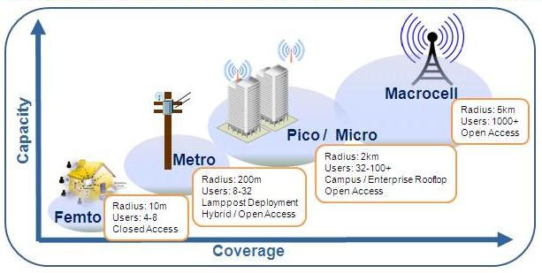

Slide 29
Advantage of using small cells
Higher capacity: Huge cells allow limited number of users/km2. Small cells can allow more users with the help of SDM, frequency reuse, FDM and frequency hopping.
Low power Tx/Rx: Power is a critical resource for mobile stations. Base stations can easily transmit high power so that the coverage area is increase but it has ill effects on the people surrounding it. Secondly mobile devices cannot do the same. Therefore small cells which requires only low transmit power are useful.
Reduced Interference: Small cells means less distance more the distance covered by antenna, more is the interference Small cells covering small distance offer less interference.
Robustness: If a base station covering large area fails, it influences connection of many people where as if it is divided into small cells, failure of BS of small cell will effect communication within a small area Small cells offer a decentralized system.
Umbrella cells: A heavily used road crosses an area when there are lots of micro cell. This would required lots of handovers as people cross the road. This is handled by umbrella cells which controls all these cells

Slide 30
Disadvantages of using small cells
Large Infrastructure: Smaller the cells, more the cells more BS are required and a complex infrastructure to connect these base stations are also
Frequent Handover: To provide uninterrupted services in form of cells or data, proper handovers are required. The frequent of handover would be more when he cell size is small and speed of movement is also more.
Frequency Planning: Smaller the cells, distribution of frequencies have to be done carefully to avoid the interference at the same time keeping in mind scarcity of frequencies.

Slide 31
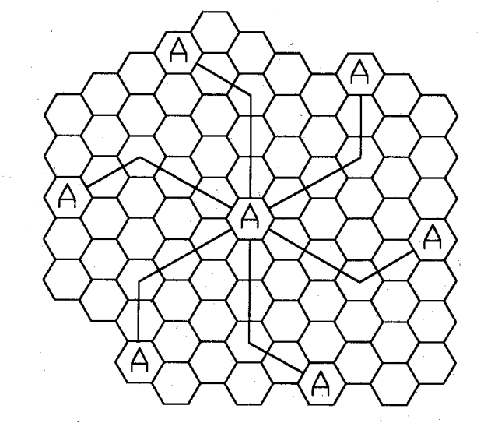
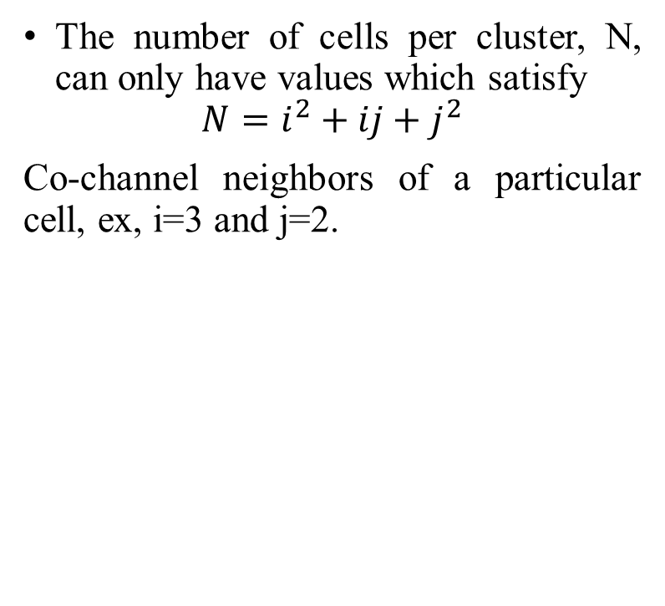
The number of cells per cluster, N, can only have values which satisfy
$$N=i^{2}+ij+j^{2}$$
Co-channel neighbors of a particular cell, ex, i=3 and j=2.

Slide 32
Channel Assignment Strategies
Channel Assignment strategies means to allocate the available channels to the cells in a cellular system whenever a user wants to make a call request then by using channel assignment strategies their requests are fulfilled. Channel Assignment Strategies are designed in such a way that there is efficient use of frequencies, time slots and bandwidth.
There are three types of Channel Assignment Strategies they are: Fixed, Dynamic, and Hybrid Channel Assignment.
Fixed Channel Assignment (FCA): It is a strategy in which fixed number of channels or voice channels are allocated to the cells. Once the channels are allocated to the specific cells then they cannot be changed. Fixed channel assignment are very simple and requires least amount of processing. Cells in this strategy are allowed to borrow channels from adjacent cells if their channels are fully occupied while adjacent cells have free channels. No interference occurs by moving the channel from one cell to another.

Slide 33
Dynamic Channel Assignment (DCA): Dynamic Channel Assignment is a strategy in which channels are not permanently allocated to the cells. When a User makes a call request then Base Station send that request to the MSC (Mobile Station Center) for the allocation of channels or voice channels. Each time a call request is made, serving BS requests a channel from the MSC. MSC assigns a channel only if it is not used and if it will not cause co‐channel interference with any cell in range. In this MSC has to collect real time data on channel occupancy, traffic distribution, radio signal strength indication of all channels on continuous basis, thus increasing the computational load on MSC.
Hybrid Channel Assignment (HCA): Hybrid Channel Allocation is a combination of both Fixed Channel Allocation (FCA) and Dynamic Channel Allocation (DCA). In this total number of channels or voice channels are divided into fixed and dynamic sets. If a user make a call then first fixed set of channels are utilized but if all the fixed sets are busy then dynamic sets are used. The main purpose of HCA is to work efficiently under heavy traffic

Slide 34
Handoff Strategies
Handoff is the technique which enables a call to proceed uninterrupted when the user moves from one cell to another.
There are two basic types of Handoffs.
1) Hard Handoff
2) Soft Handoff
Handoff process involves 3 main stages a. Handoff Initiation b. Establishing a new connection c. Data transfer to new handoffs.

Slide 35
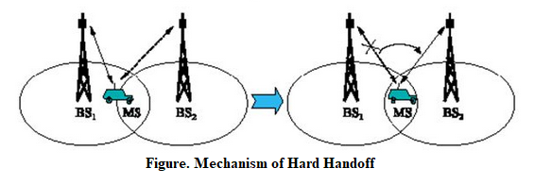
Hard Handoff:
It is also known as “Break before make” connection.
In this type of handoff the link to the old base station is terminated before the mobile station establishes a link with the new base station.
It is used in FDMA and TDMA based mobile system. Figure shows the mechanism of hard handoff.

Slide 36
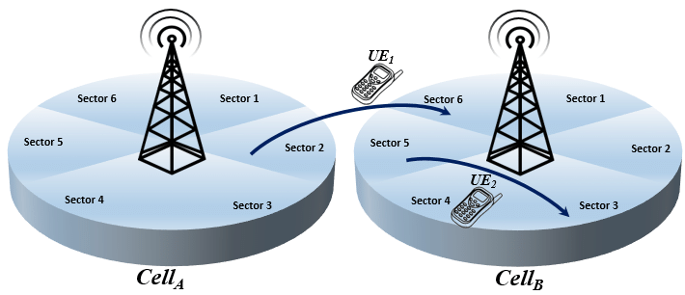
GSM: Global System for Mobile Communications
Hard handoff is classified as
Intra cell handoff:
In Intra cell Handoff, the handover occurs within the same cell.
Intra cell handover switches a cell in progress from one physical channel of a cell to another physical channel of the same cell.
Inter cell handoff:
In Inter cell Handoff, the handover occurs between two cells.
The inter cell handover switches a cell in progress from one cell to another cell.
Inter System Handoff:
In inter system handoff; the handover occurs between two systems.
This type of handoff occurs when the mobile unit moves from one cellular system to a different cellular system.
Example from GSM to UMTS.
UMTS: Universal Mobile Telecommunications System

Slide 37
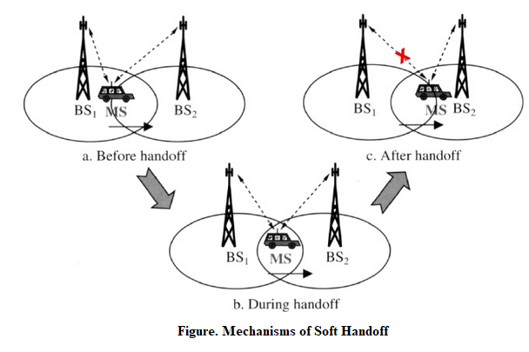
Soft Handoff:
It is also called as Mobile Directed handoff or make before Break Connection.
In these types of handoff the link to the old base station is not terminated before the mobile station established a link with the new base station.
Once the link is established the connection to old BS is terminated.
It is used in UMTS to improve the signal quality
It is more seamless handover.
Figure shows the mechanisms of soft handoff.

Slide 38
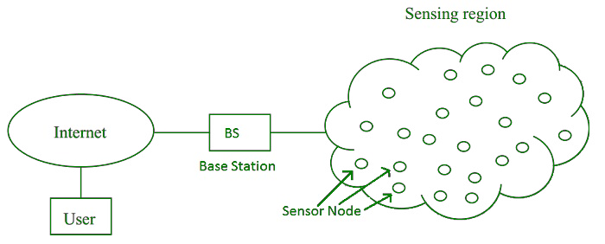
Wireless Sensor Network
Wireless Sensor Network (WSN), is an infrastructure-less wireless network that is deployed in a large number of wireless sensors in an ad-hoc manner that is used to monitor the system, physical, or environmental conditions.
Sensor nodes are used in WSN with the onboard processor that manages and monitors the environment in a particular area. They are connected to the Base Station which acts as a processing unit in the WSN System. The base Station in a WSN System is connected through the Internet to share data. WSN can be used for processing, analysis, storage, and mining of the data.

Slide 39
Wireless Sensor Network Architecture
A Wireless Sensor Network (WSN) architecture is structured into three main layers:
Physical Layer: This layer connects sensor nodes to the base station using technologies like radio waves, infrared, or Bluetooth. It ensures the physical communication between nodes and the base station.
Data Link Layer: Responsible for establishing a reliable connection between sensor nodes and the base station. It uses protocols such as IEEE 802.15.4 to manage data transmission and ensure efficient communication within the network.
Application Layer: Enables sensor nodes to communicate specific data to the base station. It uses protocols like ZigBee to define how data is formatted, transmitted, and received, supporting various applications such as environmental monitoring or industrial control.
These layers work together to facilitate the seamless operation and data flow within a Wireless Sensor Network, enabling efficient monitoring and data collection across diverse applications.

Slide 40
WSN Network Topologies
Wireless Sensor Networks (WSNs) can be organized into different network topologies based on their application and network type. Here are the most common types:
Bus Topology: In a Bus topology, multiple nodes are connected to a single line or bus. Data travels along this bus from one node to the next. It’s a simple layout often used in smaller networks.
Star Topology: Star topology have a central node, called the master node, which connects directly to multiple other nodes. Data flows from the master node to the connected nodes. This topology is efficient for centralized control.
Tree Topology: Tree topology arrange nodes in a hierarchical structure resembling a tree. Data is transmitted from one node to another along the branches of the tree structure. It’s useful for expanding coverage in hierarchical deployments.
Mesh Topology: Mesh topology feature nodes interconnected with one another, forming a mesh-like structure. Data can travel through multiple paths from one node to another until it reaches its destination. This topology offers robust coverage and redundancy.

Slide 41
Components of WSN
Sensors: Sensors in WSN are used to capture the environmental variables and which is used for data acquisition. Sensor signals are converted into electrical signals.
Radio Nodes: It is used to receive the data produced by the Sensors and sends it to the WLAN access point. It consists of a microcontroller, transceiver, external memory, and power source.
WLAN Access Point: It receives the data which is sent by the Radio nodes wirelessly, generally through the internet.
Evaluation Software: The data received by the WLAN Access Point is processed by a software called as Evaluation Software for presenting the report to the users for further processing of the data which can be used for processing, analysis, storage, and mining of the data.

Slide 42
Advantages
Low cost: WSNs consist of small, low-cost sensors that are easy to deploy, making them a cost-effective solution for many applications.
Wireless communication: WSNs eliminate the need for wired connections, which can be costly and difficult to install. Wireless communication also enables flexible deployment and reconfiguration of the network.
Energy efficiency: WSNs use low-power devices and protocols to conserve energy, enabling long-term operation without the need for frequent battery replacements.
Scalability: WSNs can be scaled up or down easily by adding or removing sensors, making them suitable for a range of applications and environments.
Real-time monitoring: WSNs enable real-time monitoring of physical phenomena in the environment, providing timely information for decision making and control.

Slide 43
Disadvantages
Limited range: The range of wireless communication in WSNs is limited, which can be a challenge for large-scale deployments or in environments with obstacles that obstruct radio signals.
Limited processing power: WSNs use low-power devices, which may have limited processing power and memory, making it difficult to perform complex computations or support advanced applications.
Data security: WSNs are vulnerable to security threats, such as eavesdropping, tampering, and denial of service attacks, which can compromise the confidentiality, integrity, and availability of data.
Interference: Wireless communication in WSNs can be susceptible to interference from other wireless devices or radio signals, which can degrade the quality of data transmission.
Deployment challenges: Deploying WSNs can be challenging due to the need for proper sensor placement, power management, and network configuration, which can require significant time and resources.

Slide 44
Bluetooth
Bluetooth is used for short-range wireless voice and data communication.
It is a Wireless Personal Area Network (WPAN) technology and is used for data communications over smaller distances.
It operates within the unlicensed, business, scientific, and clinical (ISM) bands from 2.4 GHz to 2.485 GHz.
Bluetooth stages up to 10 meters. Depending upon the version, it presents information up to at least 1 Mbps or 3 Mbps.
A Bluetooth network is called a piconet and a group of interconnected piconets is called a scatter net.

Slide 45
Key Features of Bluetooth
Bluetooth is a wireless LAN technology designed to connect devices of different functions such as telephones, notebooks, computers, cameras, printers, coffee makers, and so on. A Bluetooth LAN is an ad hoc network, which means that the network is formed spontaneously.
The transmission capacity of Bluetooth is 720 kbps.
Bluetooth is a wireless device.
Bluetooth is a Low-cost and short-distance radio communications standard.
Bluetooth is robust and flexible.
The basic architecture unit of Bluetooth is a piconet.

Slide 46
Architecture of Bluetooth
The architecture of Bluetooth defines two types of networks:
Piconet
Piconet is a type of Bluetooth network that contains one primary node called the master node and seven active secondary nodes called slave nodes.
There is a total of 8 active nodes which are present at a distance of 10 meters.
The communication between the primary and secondary nodes can be one-to-one or one-to-many.
Possible communication is only between the master and slave; Slave-slave communication is not possible.

Slide 47
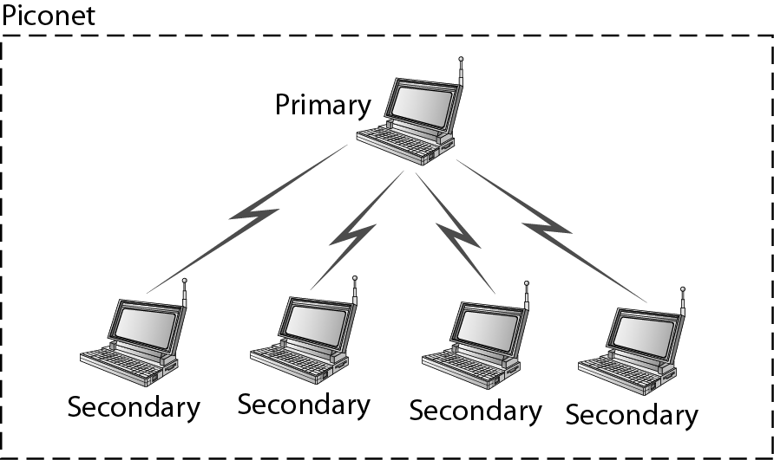

Slide 48
Scatternet
It is formed by using various piconets.
A slave that is present in one piconet can act as master or we can say primary in another piconet.
This kind of node can receive a message from a master in one piconet and deliver the message to its slave in the other piconet where it is acting as a master.
This type of node is referred to as a bridge node.

Slide 49
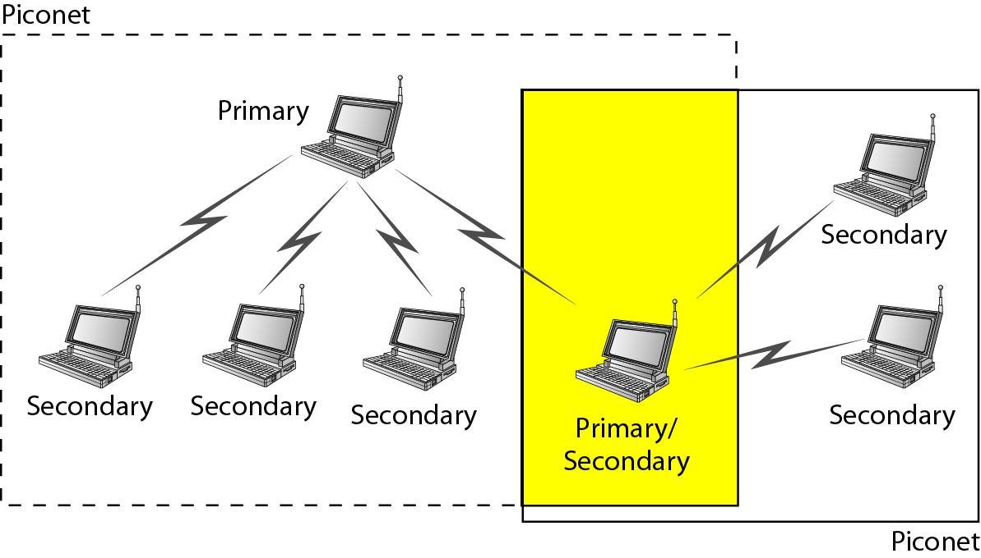

Slide 50
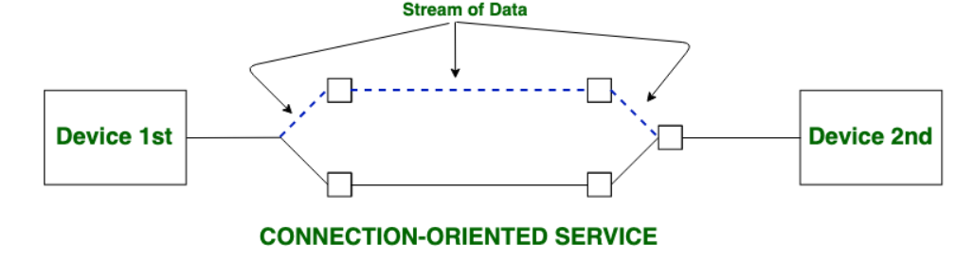
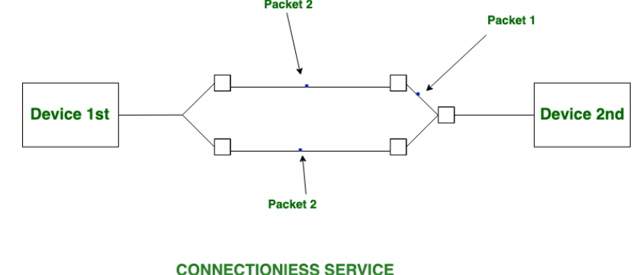
Connection-oriented service is related to the telephone system. It includes connection establishment and connection termination. In a connection-oriented service, the Handshake method is used to establish the connection between sender and receiver.
Connection-less service is related to the postal system. It does not include any connection establishment and connection termination. Connection-less Service does not give a guarantee of reliability. In this, Packets do not follow the same path to reach their destination.

Slide 51
Bluetooth Protocol Stack
Radio (RF) Layer: It specifies the details of the air interface, including frequency, the use of frequency hopping and transmit power. It performs modulation/demodulation of the data into RF signals. It defines the physical characteristics of Bluetooth transceivers. It defines two types of physical links: connection-less and connection-oriented.
Baseband Link Layer: The baseband is the digital engine of a Bluetooth system and is equivalent to the MAC sublayer in LANs. It performs the connection establishment within a piconet, addressing, packet format, timing and power control.
Link Manager Protocol Layer: It performs the management of the already established links which includes authentication and encryption processes. It is responsible for creating the links, monitoring their health, and terminating them gracefully upon command or failure.
Logical Link Control and Adaption (L2CAP) Protocol Layer: It is also known as the heart of the Bluetooth protocol stack. It allows the communication between upper and lower layers of the Bluetooth protocol stack. It packages the data packets received from upper layers into the form expected by lower layers. It also performs segmentation and multiplexing.

Slide 52
Service Discovery Protocol (SDP) Layer: It is short for Service Discovery Protocol. It allows discovering the services available on another Bluetooth-enabled device.
RF Comm Layer: It is a cable replacement protocol. It is short for Radio Frontend Component. It provides a serial interface with WAP and OBEX. It also provides emulation of serial ports over the logical link control and adaption protocol(L2CAP). The protocol is based on the (European Telecommunications Standards Institute )ETSI standard (Technical Specification) TS 07.10.
OBEX: It is short for Object Exchange. It is a communication protocol to exchange objects between 2 devices.
WAP: It is short for Wireless Access Protocol. It is used for internet access.
TCS: It is short for Telephony Control Protocol. It provides telephony service. The basic function of this layer is call control (setup & release) and group management for the gateway serving multiple devices.
Application Layer: It enables the user to interact with the application.

Slide 53
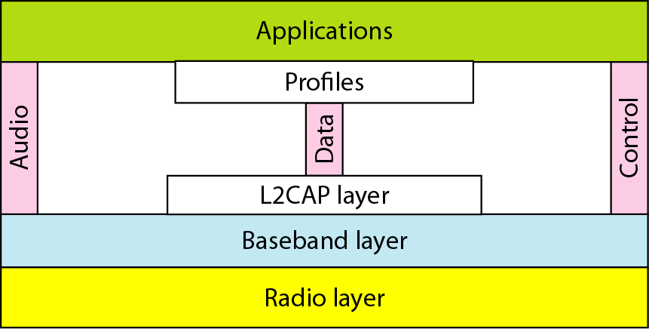
Bluetooth layers

Slide 54
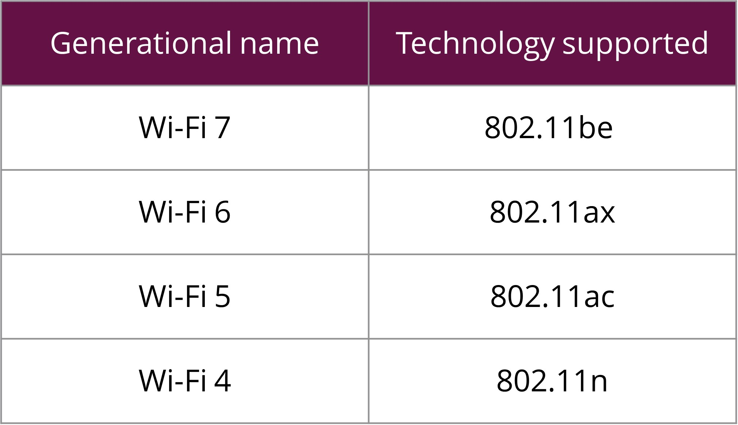
What is Wi-Fi?
Wi-Fi is a wireless networking technology that allows devices such as computers (laptops and desktops), mobile devices (smart phones and wearables), and other equipment (printers and video cameras) to interface with the Internet.
It allows these devices and many more to exchange information with one another, creating a network.
Wi-Fi uses a radio technology known as 802.11, which can transmit data over short distances using high frequencies.
https://www.copperpodip.com/post/demystifying-wi-fi-a-comprehensive-comparison-of-wi-fi-5-6-and-7

Slide 55
IEEE 802.11 Architecture
The components of an IEEE 802.11 architecture are as follows
Stations (STA): Stations comprises of all devices and equipment that are connected to the wireless LAN. A station can be of two types
Wireless Access Point (WAP): WAPs or simply access points (AP) are generally wireless routers that form the base stations or access.
Client. Clients are workstations, computers, laptops, printers, smartphones, etc.
Each station has a wireless network interface controller.
Basic Service Set (BSS): A basic service set is a group of stations communicating at the physical layer level. BSS can be of two categories depending upon the mode of operation:
Infrastructure BSS: The devices communicate with other devices through access points.
Independent BSS: The devices communicate in a peer-to-peer basis in an ad hoc manner.

Slide 56
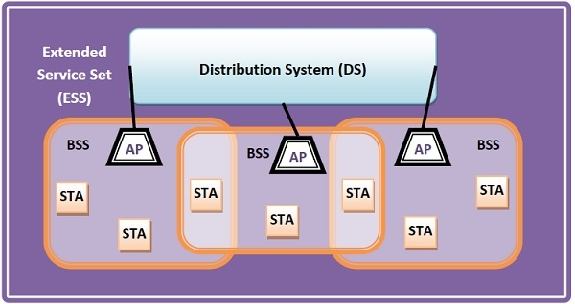
Extended Service Set (ESS): It is a set of all connected BSS.
Distribution System (DS): It connects access points in ESS.

Slide 57
Frame Format of IEEE 802.11
The main fields of a frame of wireless LANs as laid down by IEEE 802.11 are
Frame Control: It is a 2 bytes starting field composed of 11 subfields. It contains control information of the frame.
Duration: It is a 2 byte field that specifies the time period for which the frame and its acknowledgment occupy the channel.
Address fields: There are three 6 byte address fields containing addresses of source, immediate destination, and final endpoint respectively.
Sequence: It a 2 bytes field that stores the frame numbers.
Data: This is a variable-sized field that carries the data from the upper layers. The maximum size of the data field is 2312 bytes.
Check Sequence: It is a 4 byte field containing error detection information.

Slide 58
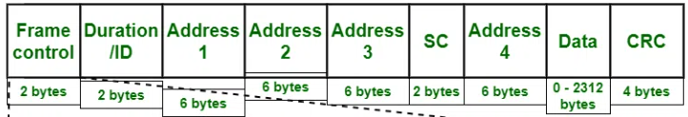
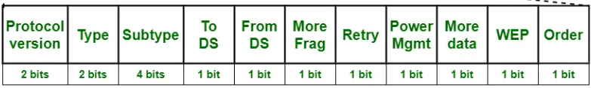

Slide 59
Frame Control
It is 2 bytes long and defines type of frame and control information.
Version: Indicates the current protocol version.
Type: Determines the function of frame i.e. management(00), control(01) or data(10).
Subtype: Indicates subtype of frame like 0000 for association request, 1000 for beacon.
To DS: When set indicates that the destination frame is for DS(distribution system).
From DS: When set indicates frame coming from DS.
More frag (More fragments): When set to 1 means frame is followed by other fragments.
Retry: If the current frame is a re-transmission of an earlier frame, this bit is set to 1.
Power Mgmt (Power Management): It indicates the mode of a station after successful transmission of a frame. Set to ‘1’ field indicates that the station goes into power-save mode. If the field is set to 0, the station stays active.
More data: It is used to indicate to the receiver that a sender has more data to send than the current frame.
WEP: It indicates that the standard security mechanism of 802.11 is applied.
Order: If this bit is set to 1 the received frames must be processed in strict order.

Slide 60
Duration / ID: It contains the value indicating the period of time in which the medium is occupied (in µs).
Address 1 to 4: These fields contain standard IEEE 802 MAC addresses (48 bit each). The meaning of each address is defined by DS bits in the frame control field.
SC (Sequence Control): It consists of 2 sub-fields i.e. sequence number (12 bits) and fragment number (4 bits). Sequence number is used to filter duplicate frames.
Data: It is a variable length field which contains information specific to individual frames which is transferred transparently from a sender to the receiver.
CRC (Cyclic Redundancy Check): It contains 32 bit CRC error detection sequence to ensure error free frame.

Slide 61
Advantages of IEEE 802.11 Architecture
Fault Tolerance: The centralized architecture minimizes the bottlenecks and introduces resilience in the WLAN equipment.
Flexible Architecture: Supports both temporary smaller networks and larger, more permanent ones.
Prolonged Battery Life: Efficient power-saving protocols extend mobile device battery life without compromising network connections.

Slide 62
Disadvantages of IEEE 802.11 Architecture
Noisy Channels: Due to reliance on radio waves, signals may experience interference from nearby devices.
Greater Bandwidth and Complexity: Due to necessary data encryption and susceptibility to errors, WLANs need more bandwidth than their wired counterparts.
Speed: Generally, WLANs offer slower speeds compared to wired LANs.

Slide 63
Applications of IEEE 802.11 Architecture
Home Networking: Connecting devices, laptops, smart TVs, speakers, gaming consoles etc.
Wi-Fi Hotspots: Free or paid internet access to visitors in coffee shops, hotels, airports, malls and restaurants.
Connectivity in Campus: Provide internet access in university, colleges, schools or corporate campuses.

Slide 64
WiMAX
WiMAX stands for Worldwide Interoperability for Microwave Access.
WiMAX is used for providing broadband internet using wireless medium mainly at 2.5GHz, 3.5GHz and 5.8GHz radio frequencies.
The IEEE 802.16 architecture lays down the standards for both physical layer as well as medium access control (MAC) layer for WiMAX.
It initially provided data rates of 30-40 Mbps.
The updated version that came in 2011 provides up to 1 Gbps data rates for fixed stations.

Slide 65
WiMAX Architecture
Subscriber stations: They are stationary in some fixed location. For example, broadband Internet for homes and offices.
Mobile stations: They receive service while they are in motion within the range of WiMAX. For example, a WiMAX equipped vehicle.
A user station connects wirelessly to the base station, forming the last wile of the broadband network through the air interface.
The base station is responsible for initiating and controlling transmission of frames.
Each frame can support both upstream and downstream data.
The base station is connected to the backbone network of the broadband service provider.
The backbone network is connected to Internet.

Slide 66
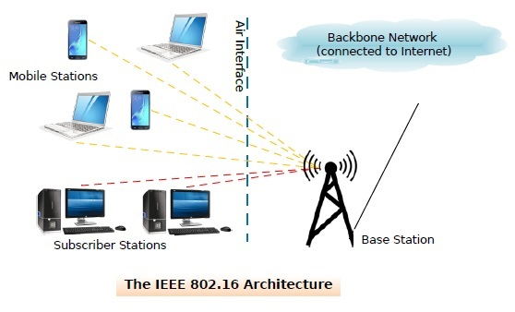

Slide 67
IEEE 802.16 Protocol Stack
IEEE 802.16 lays down the standards for physical layer and data link layer.
Physical Layer: The two popular services of the physical layer are fixed WiMAX and mobile WiMAX. They operate in the licensed spectrum below 11 GHz. Fixed WiMAX was released in 2003 and uses OFDM; while mobile WiMAX was released in 2005 and uses scalable OFDM.
Data Link Layer: The data link layer is subdivided into three sublayers
Security sublayer: This is the bottommost layer and is concerned with security and privacy of the wireless network. It deals with encryption, decryption and key management.
MAC common sublayer: The MAC sublayer is concerned with channel management. The channel management is connection oriented, a feature that plays due to which quality of service (QoS) guarantees are given to the subscriber. The base station controls the system. It schedules the channels from base station to the subscriber (downlink channels) and also manages the channels from the subscriber to the base station (uplink channels).
Service specific convergence sublayer: This is equivalent to logical link control layer of other systems. It provides the required services and interface to network layer.

Slide 68
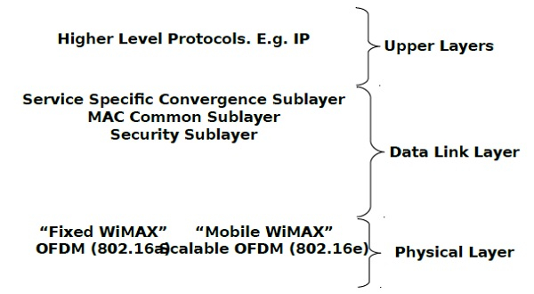

Slide 69
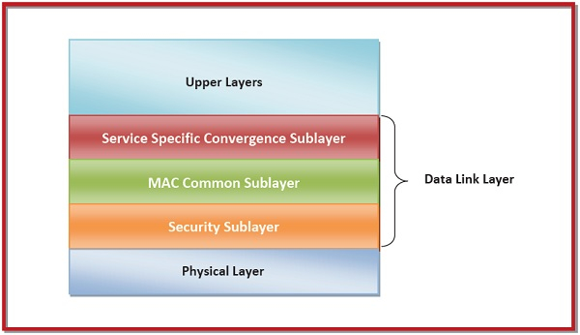

Slide 70
MAC Sublayer Features
The main features of MAC sublayer for WiMAX are
Support for broadcast and multicast services.
Primitives imparting high-speed handover and mobility management.
MAC layer security has privacy key management (PKM). PKM version 2 provides support for extensible authentication protocol (EAP).
Energy efficiency through three power management modes, normal, sleep, and ideal.
Efficient use of spectrum through methods like header suppression, packing, and fragmentation.
Primitives for manageability.

Slide 71
Advantages of WiMAX
Wide Coverage Area: WiMAX can cover an area of up to 50 kilometers, making it suitable for providing broadband access in rural and underserved areas.
High Data Rates: WiMAX can provide data rates of up to 75 Mbps, which is higher than many other wireless technologies.
Scalability: WiMAX can be easily scaled to support a large number of users and devices.
Interoperability: WiMAX is based on an international standard, which allows for interoperability between different vendors’ equipment.
Cost-effective: WiMAX is a cost-effective solution for providing broadband access in areas where it is not economically feasible to deploy wired infrastructure.

Slide 72
Disadvantages of WiMAX
Limited Mobility: WiMAX is designed for fixed or nomadic (semi-fixed) use, not for mobile use.
Interference: WiMAX operates in the same frequency range as other wireless technologies, which can lead to interference.
Security Concerns: WiMAX uses a shared spectrum, which can make it vulnerable to security threats such as jamming.
Limited device availability: WiMAX devices are not as widely available as devices for other wireless technologies, such as WiFi.
Limited penetration: WiMAX signals may have trouble penetrating through walls, buildings and other obstacles.

Slide 73
ZigBee or Xbee
Zigbee is also a wireless network communications protocol sitting on top of the IEEE 802.15.4 standard and is designed for short-range applications to create a Low-Power Wireless Personal Area Network (LP-WPAN)
It operates on IEEE 802.15.4 physical radio specification and operates even in unlicensed band including 2.4 GHz, 900 MHz and 868 MHz.
The ZigBee protocol is robust in a way to be used in various hostile RF, Wi-Fi, Bluetooth based environments, which are common in various industrial applications.
ZigBee is an open, global, packet-based protocol designed to provide an easy-to-use architecture for secure, reliable, low power wireless networks.
ZigBee is a standard that addresses the need for very low-cost implementation of Low power devices with Low data rates for short-range wireless communications.

Slide 74
Zigbee architecture
Physical layer: The lowest two layers i.e the physical and the MAC (Medium Access Control) Layer are defined by the IEEE 802.15.4 specifications. The Physical layer is closest to the hardware and directly controls and communicates with the Zigbee radio. The physical layer translates the data packets in the over-the-air bits for transmission and vice-versa during the reception.
Medium Access Control layer (MAC layer): The layer is responsible for the interface between the physical and network layer. The MAC layer is also responsible for providing PAN ID and also network discovery through beacon requests.

Slide 75
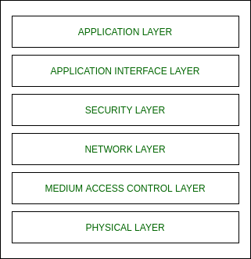
Network layer: This layer acts as an interface between the MAC layer and the application layer. It is responsible for mesh networking.
Application layer: The application layer in the Zigbee stack is the highest protocol layer and it consists of the application support sub-layer and Zigbee device object. It contains manufacturer-defined applications.

Slide 76
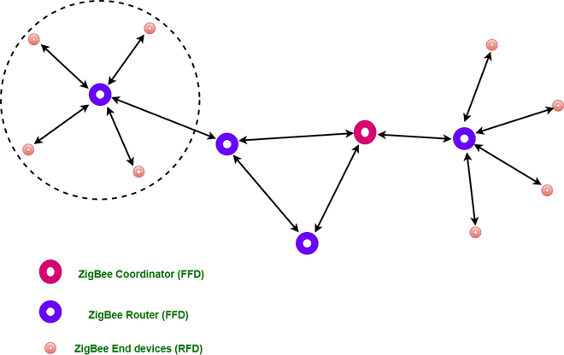
Types of ZigBee Devices:
Zigbee Coordinator Device: It communicates with routers. This device is used for connecting the devices.
Zigbee Router: It is used for passing the data between devices.
Zigbee End Device: It is the device that is going to be controlled.
Full-function device (FFD), Reduced-function device (RFD).

Slide 77
Zigbee topologies
Depending on the available device types and their number, Zigbee supports the following network topologies:
Star topology: The coordinator communicates directly with the end devices and no routers are actively present, meaning they are either not present or not routing packets within the network.
Tree topology: It routers are located beyond their mutual radio range and are not able to communicate with each other. However, unlike in the star topology, the routers continue to move packets through the network.
Mesh topology: It allows full peer-to-peer communication.

Slide 78
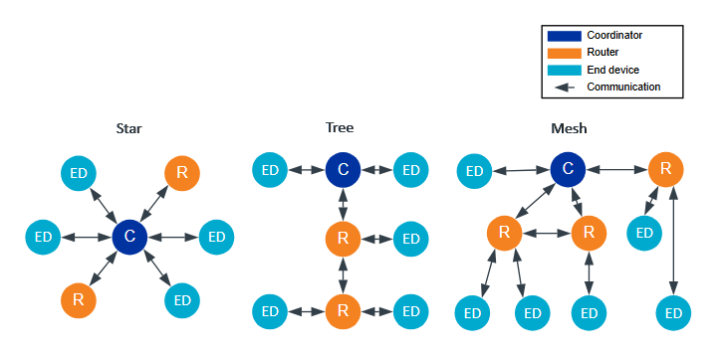

Slide 79
General Characteristics of Zigbee Standard:
Low Power Consumption
Low Data Rate (20- 250 kbps)
Short-Range (75-100 meters)
Network Join Time (~ 30 msec)
Support Small and Large Networks (up to 65000 devices (Theory); 240 devices (Practically))
Low Cost of Products and Cheap Implementation (Open Source Protocol)
Extremely low-duty cycle.
3 frequency bands with 27 channels.
Operating Frequency Bands (Only one channel will be selected for use in a network):
Channel 0: 868 MHz (Europe)
Channel 1-10: 915 MHz (the US and Australia)
Channel 11-26: 2.4 GHz (Across the World)

Slide 80
Features of Zigbee:
Stochastic addressing: A device is assigned a random address and announced. Mechanism for address conflict resolution. Parents node don’t need to maintain assigned address table.
Link Management: Each node maintains quality of links to neighbors. Link quality is used as link cost in routing.
Frequency Agility: Nodes experience interference report to channel manager, which then selects another channel
Asymmetric Link: Each node has different transmit power and sensitivity. Paths may be asymmetric.
Power Management: Routers and Coordinators use main power. End Devices use batteries.

Slide 81
Advantages of Zigbee:
Designed for low power consumption.
Provides network security and application support services operating on the top of IEEE.
Zigbee makes possible completely networks homes where all devices are able to communicate and be
Use in smart home
Easy implementation
Adequate security features.
Low cost: Zigbee chips and modules are relatively inexpensive, which makes it a cost-effective solution for IoT applications.
Mesh networking: Zigbee uses a mesh network topology, which allows for devices to communicate with each other without the need for a central hub or router. This makes it ideal for use in smart home applications where devices need to communicate with each other and with a central control hub.
Reliability: Zigbee protocol is designed to be highly reliable, with robust mechanisms in place to ensure that data is delivered reliably even in adverse conditions.

Slide 82
Disadvantages of Zigbee
Limited range: Zigbee has a relatively short range compared to other wireless communications protocols, which can make it less suitable for certain types of applications or for use in large buildings.
Limited data rate: Zigbee is designed for low-data-rate applications, which can make it less suitable for applications that require high-speed data transfer.
Interoperability: Zigbee is not as widely adopted as other IoT protocols, which can make it difficult to find devices that are compatible with each other.
Security: Zigbee’s security features are not as robust as other IoT protocols, making it more vulnerable to hacking and other security threats.

Slide 83
What is RFID technology
Radio-Frequency Identification (RFID) technology is widely used in industries because it simplifies and automates processes.
It uses radio waves to communicate, to identify, and track objects wirelessly, making it a valuable tool for a variety of applications, from supply chain management to access control.
It is a wireless technology that uses radio waves to identify and track objects by placing an RFID tag or transponder on them.
The tag contains a microchip and an antenna that transmits a unique identifier to a reader device when prompted by the reader's radio signal.

Slide 84
Main benefits of RFID
Improved efficiency: RFID technology enables fast and efficient data exchange between an RFID reader and an RFID tag, which can result in improved efficiency and accuracy in various applications, such as inventory management, supply chain management, and asset tracking.
Increased visibility: RFID technology provides real-time data and increased visibility into the movement of goods and assets, enabling organizations to make more informed decisions and respond quickly to changes in demand or other conditions.
Reduced costs: By automating processes and reducing manual labor, RFID technology can help organizations to reduce costs and improve their bottom line. For example, RFID can help reduce inventory shrinkage and improve asset utilization, both of which can lead to significant cost savings.
Improved security: RFID technology can be used to enhance security by controlling access to secure areas and facilities and by helping to prevent theft and shrinkage.
Improved consumer engagement: RFID technology can also be applied to create an engaging shopping experience for consumers by providing personalized recommendations, real-time product information, and location-based marketing.

Slide 85


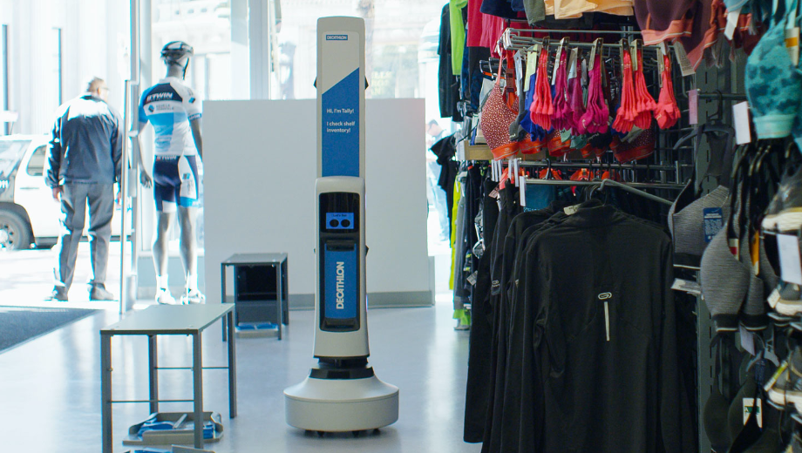
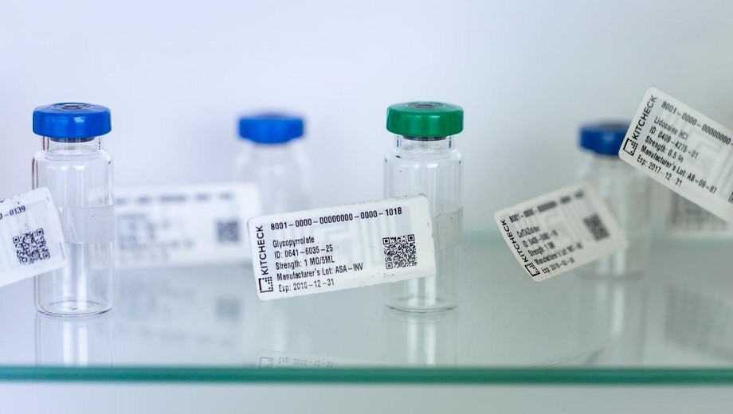
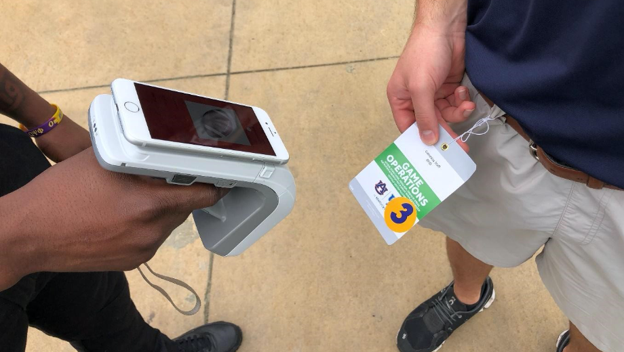

Application areas
Due to its ability to provide quick and accurate identification and tracking objects, RFID technology has found widespread use in various industries.
Supply chain management
Asset tracking
Inventory management
Healthcare
Access control
Retail

Slide 86
Passive vs Active RFID tags
An RFID tag is a part of RFID technology, which is used to track and identify objects wirelessly, and there are two main types of RFID tags: passive and active. Each type has its own unique advantages, and the choice between them will depend on the specific needs of the application.
Passive RFID tags: These tags do not have an internal power source and rely on the energy from the RFID reader to power the tag and transmit data. Passive RFID tags are the most widely used type of RFID tag and are typically less expensive than active RFID tags. They are commonly used in applications such as retail inventory management, asset tracking, and access control. Passive sensors are also used in embedded solutions where the tag offers an unique ID for the product over its lifetime.
Active RFID tags: These tags have an internal power source, typically a battery, that allows them to transmit data over longer distances. Active RFID tags are often used in applications such as supply chain management and asset tracking, where long-range identification is required. They are generally more expensive than passive RFID tags.

Slide 87
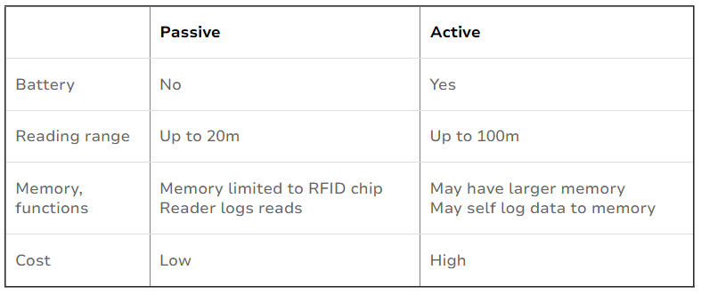
The choice between passive and active RFID tags will depend on the specific needs of the application. Passive RFID may be a better choice for applications that require low cost, small size and long lifetime, while active RFID may be a better choice for applications that require long range and continuous data transmission. Since most of the tags in the market are passive, this guide focuses on passive RFID.

Slide 88
Components of an RFID system
An RFID tag is a part of RFID technology. It is a small device that contains a microchip and an antenna, which work together to transmit and receive data wirelessly using radio waves.
An RFID system, on the other hand, includes not only the RFID tags, but also the RFID readers, the host system, and other components that work together to identify, track, and manage objects.
An RFID system is the complete solution that uses the RFID technology to solve specific business problems or address application requirements.
An RFID system typically consists of the following main components: the reader, the antenna, the tag, and the host system. Each component plays a critical role in the overall operation of the system.

Slide 89
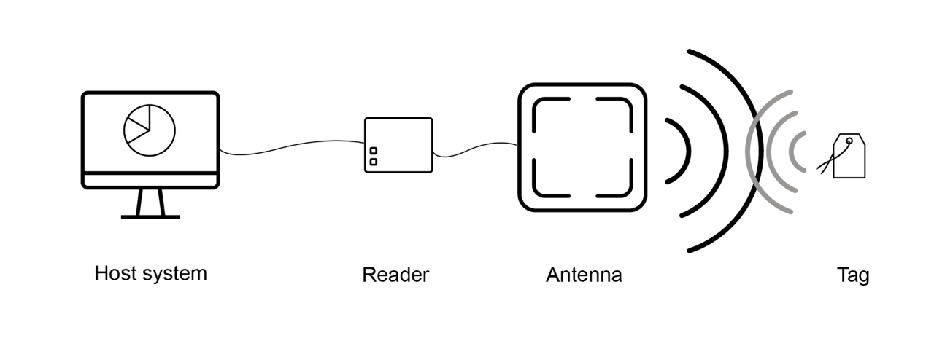

Slide 90
Reader: The reader is the heart of the RFID system. It is responsible for transmitting the radio frequency energy to activate the tag and for receiving and decoding the data transmitted by the tag. The reader typically consists of a radio frequency (RF) module, a microprocessor, and an interface for connecting to the host system.
Antenna: The antenna is responsible for transmitting the radio frequency energy from the reader to the tag and for receiving the data transmitted by the tag. The antenna can be designed in various shapes and sizes to suit different applications, and it can be integrated into the reader or attached as a separate component.
Tag: The tag is the component that is attached to the item being tracked. It contains a microchip and an antenna (a tag also has an antenna, don’t mix it up with the reader’s antenna), and it is responsible for storing and transmitting the data associated with the item. The tag can be passive, relying on the energy transmitted from the reader to activate and transmit its data, or it can be active, with its own power source.
Host system: The host system refers to the software and hardware infrastructure that manages and controls the RFID system. It typically consists of a computer, server or cloud-based platform that runs software, which communicates with RFID readers and collects data from RFID tags.

Slide 91
https://rfid.averydennison.com/en/home/explore-rfid/rfid-technology-basics.html

